Slide 2
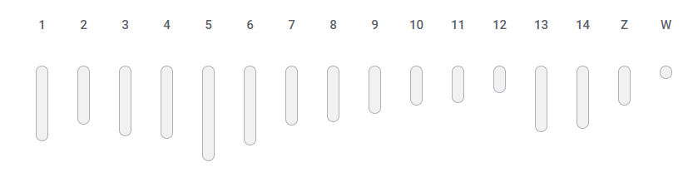
Published Lepeophtheirus salmonis genome assemblies (from the NCBI GenBank)
Assembly | Size, Mb | Level | Repeats, % | Reference | Sex
UVic_Lsal_1.4 | 647.1 | Chromosome | 56.67 | Joshi et al. (2022) G3, 12(6), jkac087 | ♀
LSAL_IOA00-2.0 | 623.5 | Chromosome | - | - | ♀
LSAL_IOA00_R2 | 632.2 | Chromosome | - | - | ♀
lsal_atl_canada | 665.1 | Contig | - | - | ♀
lsal_atl_canada | 665.3 | Contig | - | - | ♂
ASM18125v2 (!) | 790.1 | Contig | - | - | ?
Our genome | 623.5 | Chromosome | - | - | ?
Chromosomes (nuclear) + 1 mitochondrial

Slide 3
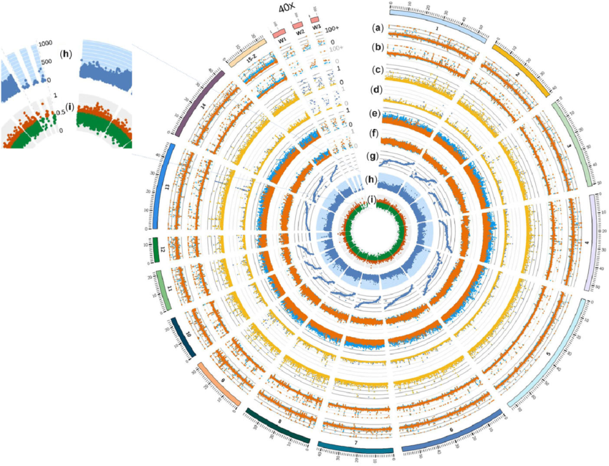
Repetitive elements for identification of Lepeophtheirus salmonis
Some repeats are species-specific, serving as molecular markers for identifying species.
Repetitive elements are abundant. This can make them easier to detect and amplify.
Circos plot of L. salmonis genome assembly. (i) The ratio of repetitive elements within10 kb windows. Orange points are greater than 0.5 (top half). From [Joshi et al. (2022) G3, 12(6), jkac087].

Slide 4
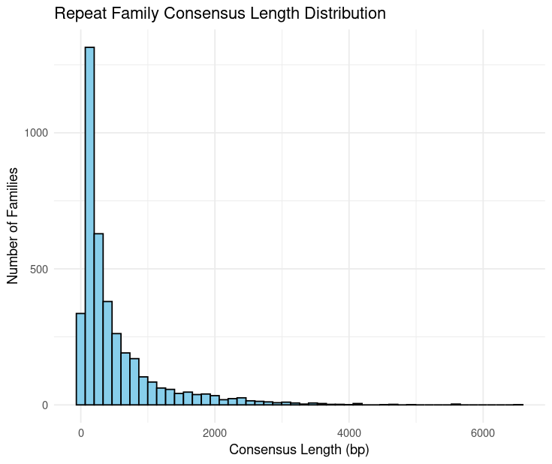
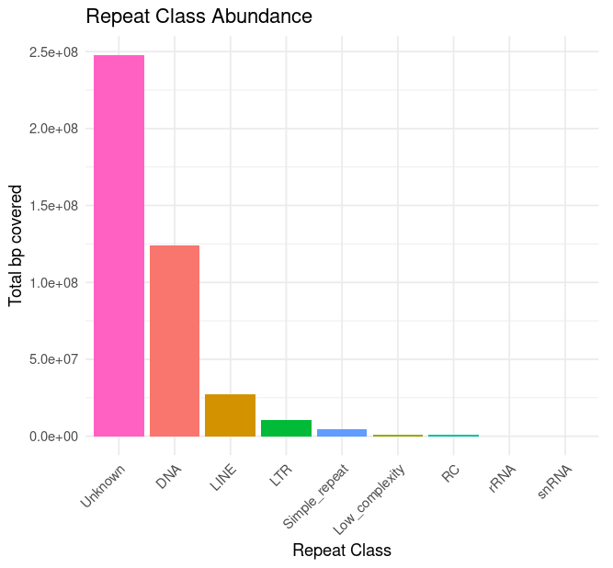
Repeat statistics for the Lepeophtheirus salmonis genome
De novo repeats search: RepeatModeler (Flynn et al.(2020) PNAS, 117(17), 9451-9457) .
Repeats annotation: RepeatMasker (Chen (2004) Cur Protoc. Bioinf., 5(1), 4-10.) + Pfam database (Finn et al. (2014) NAR, 42(D1), D222-D230) + RECON (Bao, Eddy (2002) Genome Res, 12(8), 1269-1276), RepeatScout (Price et al. (2005) Bioinf., 21(suppl_1), i351-i358.)
Search: RMBlast.
Class | Number | Total Length, nt
Unknown | 1,747,631 | 247,696,234
DNA | 462,125 | 124,140,232
LINE | 85,600 | 27,346,479
LTR | 25,727 | 10,474,434
Simple_repeat | 125,568 | 4,591,053
Low_complexity | 20,184 | 905,882
RC | 4,418 | 864,458
rRNA | 417 | 59,983
snRNA | 84 | 11,883
Total of 2471754 repeats.
Total of 416.1 Mb of 623.5 Mb (66.7% of the genome). Reference genome: 56.7%.
# | Family | # | Family
1 | Unknown | 11 | DNA/hAT-hAT-19
2 | DNA/TcMar-Tc1 | 12 | DNA/hAT-Ac
3 | LINE/L1 | 13 | DNA/hAT-Tip100
4 | DNA/P | 14 | DNA/MULE-MuDR
5 | LTR/Gypsy | 15 | LTR/Pao
6 | DNA/hAT-nAT.m | 16 | LINE/CR1
7 | DNA/TcMar-Marinner | 17 | DNA/CMC-Chapaev-3
8 | DNA/hAT-Charlie | 18 | DNA/Sola-2
9 | DNA/PiggyBac | 19 | DNA/CMC-Chapaev
10 | LINE/R1-LOA | 20 | DNA-???

Slide 5
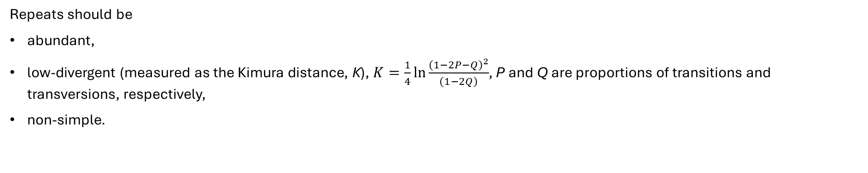
Filtering: how to select ‘good’ repeats for the identification task
Repeats should be
abundant,
low-divergent (measured as the Kimura distance, K), $K=\frac{1}{4}ln\frac{{\left(1−2P−Q\right)}^{2}}{\left(1−2Q\right)}$, P and Q are proportions of transitions and transversions, respectively,
non-simple.
1) Input data
2) Filtering of low complexity repeats and microsatellites
3) Selection of high-abundant repeats (take top 20 families)
4) Selection of low-divergence reads (<5 %)
 | Input |  | Filtering low complexity |  | Selection of top20 |  | Low-divergent only
 | Number | % of initial | Number | % of initial | Number | % of initial | Number | % of initial
Repeats | 2,471,754 | 100 | 2,326,002 | 94.1 | 318,283 | 12.9 | 35,363 | 1.4
Size (nt) | 416,090,638 | 100 | 410,593,703 | 98.7 | 53,245,993 | 12.8 | 7,792,023 | 1.9

Slide 6
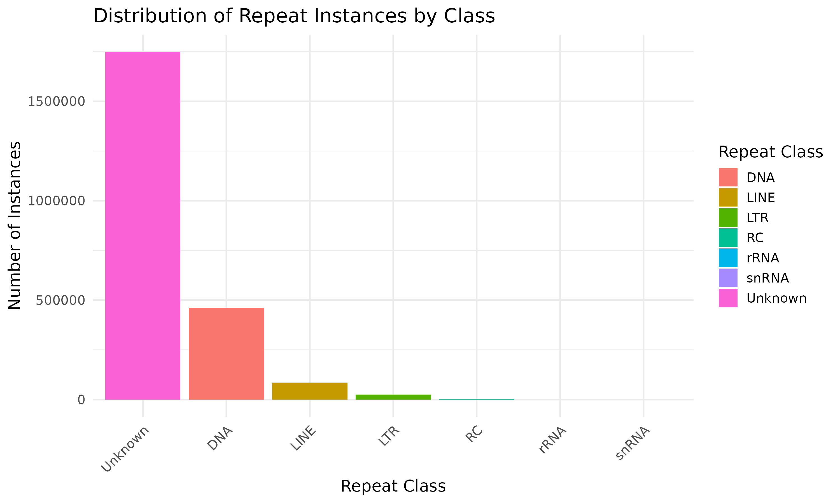
Filtering: how to select ‘good’ repeats for the identification task
Before filtering
After filtering
 | Input |  | Filtering low complexity |  | Selection of top20 |  | Low-divergent only
 | Number | % of initial | Number | % of initial | Number | % of initial | Number | % of initial
Families | 7486 | 100 | 3885 | 51.9 | 20 | 0.3 | 20 | 0.3
Classes | 9 | 100 | 7 | 77.8 | 5 | 55.6 | 5 | 55.6

Slide 7
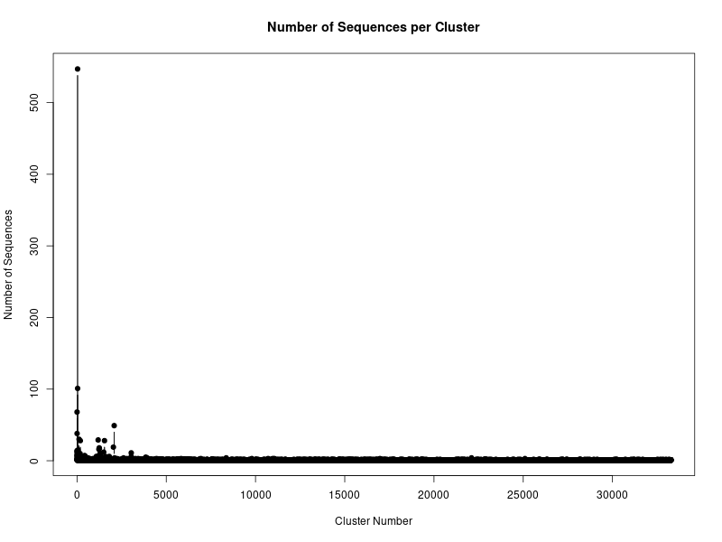
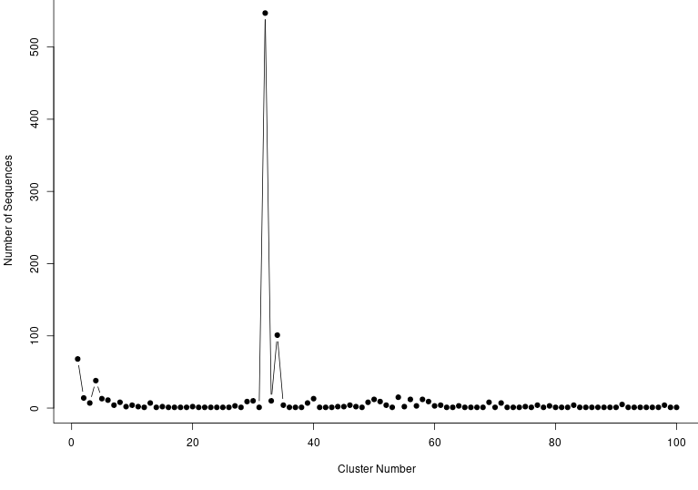
Clusterisation of filtered repeats of Lepeophtheirus salmonis
Sequences were clustered by CD-HIT-EST (Huang et al. (2010) Bioinformatics, 26(5), 680-682).
cd-hit-est -i ~/priming_regions.fasta -o ~/Repeats/cd_hit/clustered_top20.fasta -c 0.85 -n 8 -T 4 -M 16000 -d 0
# -c: homology threshold, -n: k-mer size, -T: number of CPU threads.
35,363 repeat sequences in 33,275 clusters.
Only two large clusters (>100): #32 and #34.
All sequences are from the family DNA/hAT-19.
#32: 547 repeats
Flashback: рhigh abundance does not guarantee that this target is suitable.
#34: 101 repeat
# | Family | # | Family
1 | Unknown | 11 | DNA/hAT-hAT-19
2 | DNA/TcMar-Tc1 | 12 | DNA/hAT-Ac
3 | LINE/L1 | 13 | DNA/hAT-Tip100
4 | DNA/P | 14 | DNA/MULE-MuDR
5 | LTR/Gypsy | 15 | LTR/Pao
6 | DNA/hAT-nAT.m | 16 | LINE/CR1
7 | DNA/TcMar-Marinner | 17 | DNA/CMC-Chapaev-3
8 | DNA/hAT-Charlie | 18 | DNA/Sola-2
9 | DNA/PiggyBac | 19 | DNA/CMC-Chapaev
10 | LINE/R1-LOA | 20 | DNA-???

Slide 8
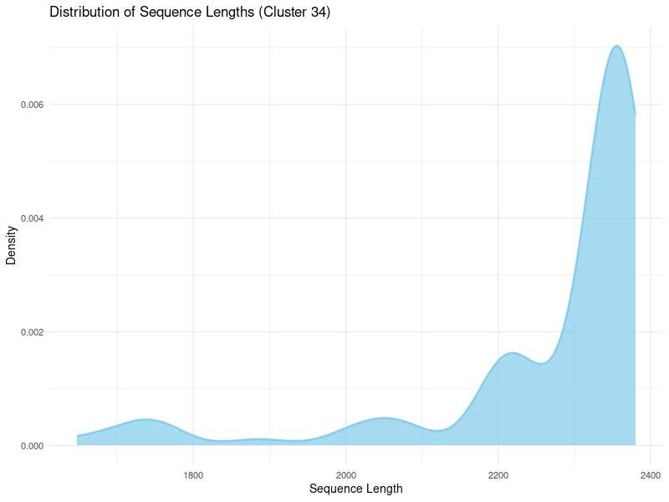
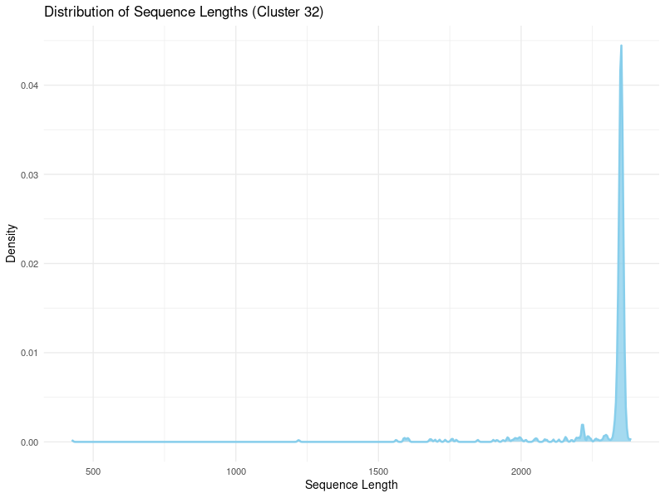
Clusterisation of filtered repeats of Lepeophtheirus salmonis for primer design

Slide 9
Primer selection and in silico PCR
Primer design: DECIPHER (Wright et al. (2014) Environ. Microbiol. 16(5) 1354-1365) + Oligoarray (Rouillard et al (2003) NAR, 31(12), 3057-3062), function DesignPrimers(). Parameters: 50 mM NaCl, 0.5 µM primer.
In silico PCR: primer-BLAST (Ye et al. (2012) BMC Bioinformatics, 13, 1-11). Parameters: 50 mM NaCl, 1.5 mM MgCl2, 0.5 µM primers. Sequence source: NCBI GenBank.
Name | Sequence | tm, °C | Warnings | Name | Sequence | tm, °C | Warnings
Ls32_1F | RCTTGTGTWTTGCAACCTAAAGTTAT | 62.3 | NO | Ls32_1R | AKAAAAAMGCGTGCGAGGAG | 66.1 | NO
Ls32_2F | AKAAAAAMGCGTGCGAGGAG | 66.1 | NO | Ls32_2R | TGTAGTAATGTCCRGYGATATTACT | 59.8 | YES
Ls32_3F | AKAAAAAMGCGTGCGAGGAG | 66.1 | NO | Ls32_3R | ATGTAGTAATGTCCRGYGATATTACT | 60.0 | YES
Ls32_4F | AKAAAAAMGCGTGCGAGGAG | 66.1 | NO | Ls32_4R | GYAACTACCCYCGTTGTTGTG | 64.0 | NO
Ls32_5F | AKAAAAAMGCGTGCGAGGAG | 66.1 | NO | Ls32_5R | GTAGTAATGTCCRGYGATATTACTC | 59.0 | YES
Ls34_1F | RGGCAAAAACAACTGYTTAAATGGTC | 67.8 | NO | Ls34_1R | CCYATCAACCATARCTAAGCCTT | 63.0 | NO
Ls34_2F | RGGCAAAAACAACTGYTTAAATGGTC | 67.8 | YES | Ls34_2R | TGTWACTACCCYCGTTGTTGT | 61.2 | YES
Ls34_3F | RGGCAAAAACAACTGYTTAAATGGTC | 67.8 | NO | Ls34_3R | GRAAAACCTAATKATCATACCCAAGT | 62.7 | NO
Ls34_4F | RGGCAAAAACAACTGYTTAAATGGTC | 67.8 | NO | Ls34_4R | CCCATYAACCATARCTAAGCCT | 62.8 | NO
Ls34_5F | RGGCAAAAACAACTGYTTAAATGGTC | 67.8 | NO | Ls34_5R | ATGTAGTAATGTCCRGYGATATTACT | 60.0 | YES
All PCR products are L. salmonis sequences (Uvic_Ls, IoA-00).
Note: Ls32 – ~500 bp, 2500 bp. Ls32_5 – additional strange proteins of L. salmonis. Ls34 – very many 180 bp seqences.
No results with other Lepiophtherus spp. No results Crustacea.

